Slide 1
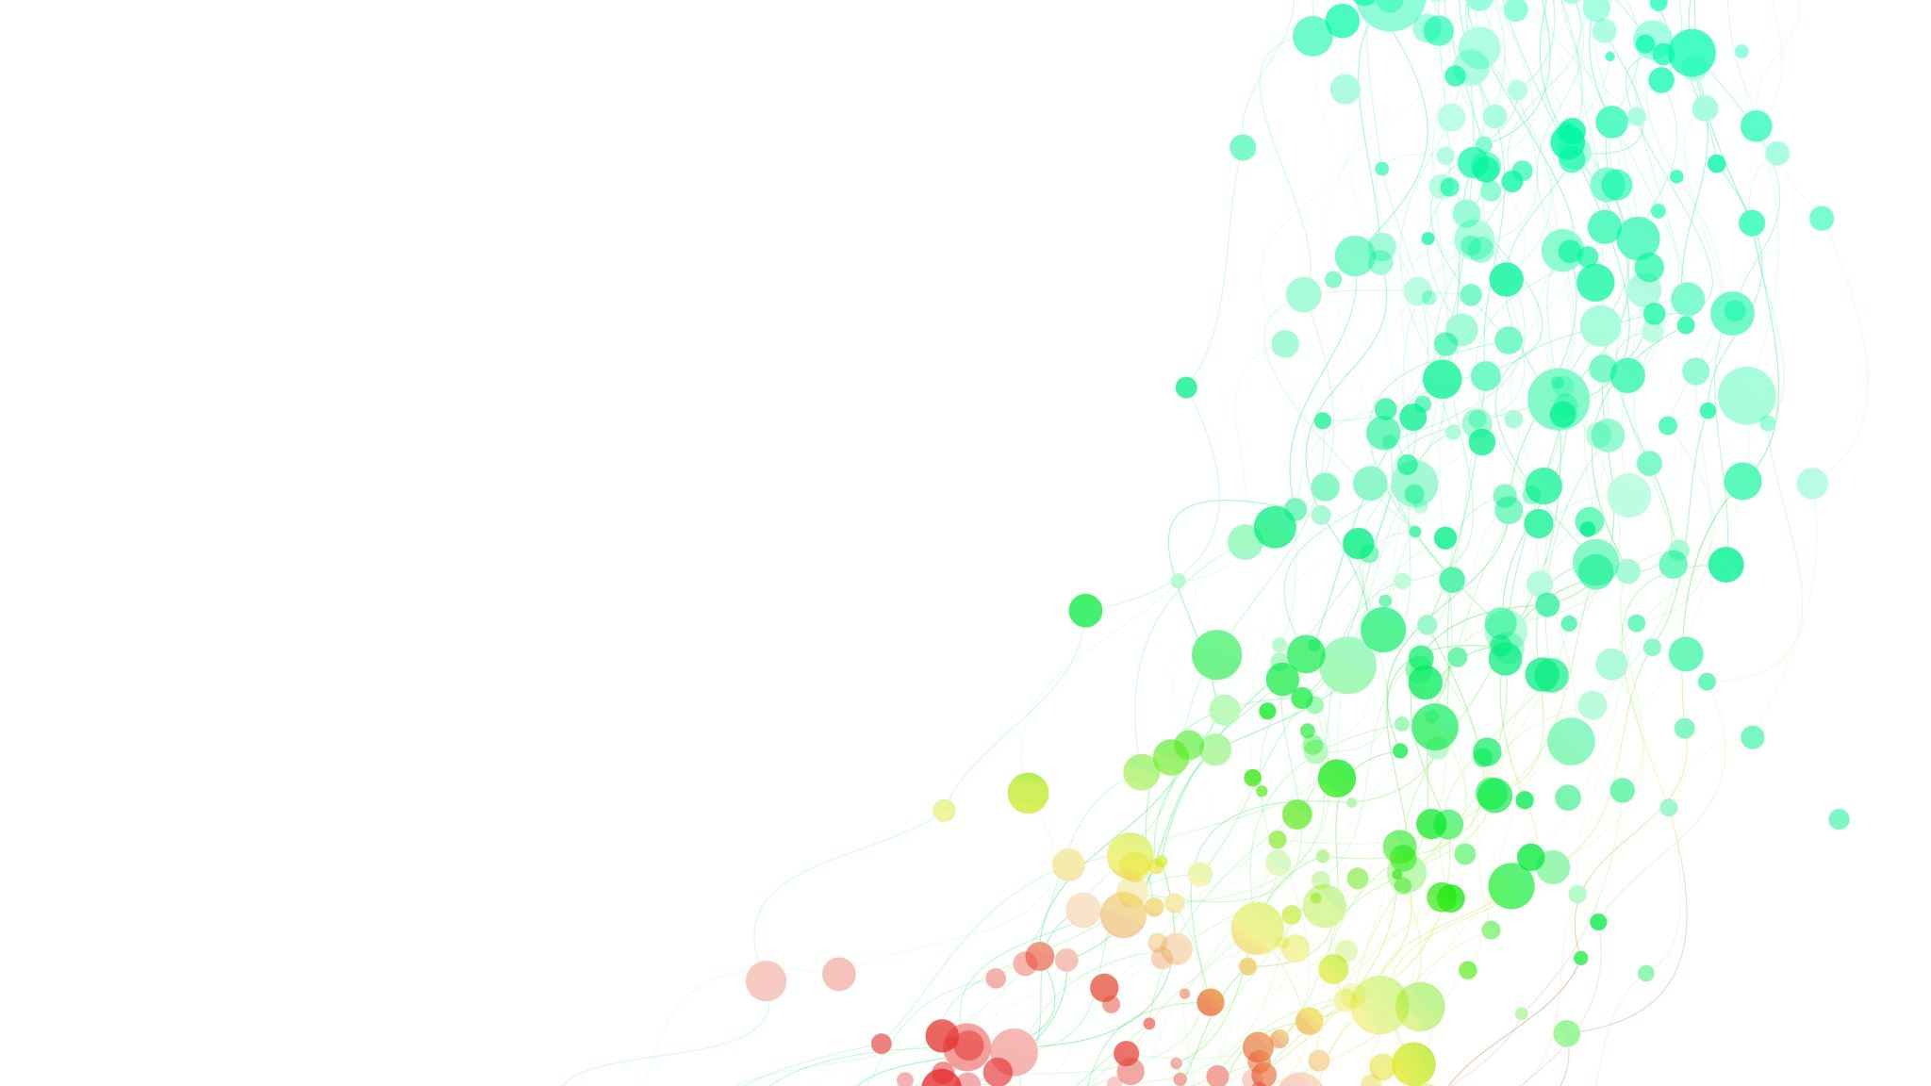
Enhancing Data Compression: A Dynamic Programming Approach with Huffman Coding and Burrows-Wheeler Transform​

Slide 2

Abstract
Data compression is a vital method for reducing the size of digital data to save space and make transmitting it quicker.
A novel data compression method is introduced, combining Huffman coding and the Burrows-Wheeler Transform (BWT) to efficiently compress images. This algorithm rearranges data using BWT and assigns shorter codes to frequently occurring characters with Huffman coding.
Experimental results demonstrate that the combined approach achieves higher compression ratios across various image types and is efficient for both encoding and decoding. In conclusion, the algorithm shows potential for applications involving large image storage and transmission.

Slide 3
Objective
In the digital age, the demand for efficient data storage has surged, necessitating the reduction of file sizes without compromising crucial information​
This research aims to conduct a comparative analysis of the effectiveness of Huffman coding and BWT in reducing data size and improving data transfer speeds​
To achieve this, we will employ dynamic programming, a technique used to optimize algorithms by breaking down complex problems into manageable components, to enhance the performance of these compression methods​
The primary objective of this study is to develop a reliable data compression method that reduces data size while preserving data integrity​
The goal is to contribute to the development of more efficient data compression methods, addressing the escalating demands of our data-driven world

Slide 4
Compression Methods
Lossless Compression: reduce data size while retaining all details, ensuring perfect data restoration, making them suitable for text files, code, and data that require exact preservation​.
Lossy Compression: often achieves a higher level of compression as compared to lossless by omitting less crucial information, thus making it more suitable for multimedia content like images and videos, where minor data loss may go unnoticed.
Thus, the choice of which method to use depends on the data type and the desired balance between compression and data fidelity.

Slide 5
Proposed Study
Efficient Data Reordering: BWT reorders data to create highly compressible patterns, making it an ideal preprocessing step for Huffman coding.
Variable-Length Encoding: Huffman coding assigns variable-length codes, optimizing the encoding of symbols and enhancing data representation.
Enhanced Compression Ratios: Combining BWT and Huffman coding consistently results in superior compression ratios, as demonstrated in our empirical tests.

Slide 6
Phases of Study
Gathering data: Initially, we will assemble a range of images with varying resolutions and colour depths. This dataset will facilitate the evaluation of compression effectiveness for both algorithms.
Algorithm implementation: The subsequent stage involves coding of Huffman and BWT algorithms using python programming language.
Image Compression: Apply the Huffman and BTW algorithms to compress the images and compare the compression ratios produced by each algorithm.
Evaluating Image Quality: The study will then assess the quality of the compressed images by computing two metrics: the Peak Signal to Noise Ratio (PSNR) and the Structural Similarity Index (SSIM).
Result Comparison: Finally, the study will juxtapose the outcomes from both algorithms based on their compression ratios, PSNR, and SSIM values. Additionally, the algorithms' performance will be analysed in relation to images with diverse resolutions and colour depths.

Slide 7

Calculating Compression Factor
Original Size: Calculate the original size of the data in bits. This is usually done by multiplying the number of bytes in the original data by 8 (since there are 8 bits in a byte). In your case, this would be the size of the image data before compression.
Compressed Size: Calculate the size of the data after compression in bits. This can be determined by counting the number of bits in the compressed data, considering any additional overhead introduced by compression methods.
Compression Factor: Calculate the compression factor by dividing the original size by the compressed size. The formula is:
Compression Factor = Original Size / Compressed Size

Slide 8

Huffman Algorithm
Huffman Coding: Lossless compression method for images without compromising quality; shorter codes for common symbols, longer for less common.
Frequency Assessment: Evaluate pixel value frequency to create a Huffman tree; each leaf node represents a pixel value and its associated frequency.
Compression Advantage: Structuring the Huffman tree assigns concise codes to common pixel values, resulting in a compressed file with fewer bits. This reduces storage space and resource requirements during transmission.
Encoding: Replace each pixel value with its Huffman code in the encoding process, creating a compressed image file suitable for efficient storage or transmission.
Decoding: Utilize the same code table to reverse the process during decoding, converting Huffman codes back to pixel values and successfully reconstructing the original image with preserved quality.

Slide 9
Huffman Algorithm Pseudocode
Construct a frequency table for all symbols in the image.
1
Create a Huffman tree using the frequency table.
2
Generate a code table from the Huffman tree.
3
Compress the image using the code table.
4
Decompress the data using the Huffman tree.
5
Return the decompressed data.

Slide 10
Burrow-Wheeler Transform Algorithm
Burrows-Wheeler Transform (BWT): Lossless compression technique utilizing reversible permutation-based transformation.
Reorganization of Data: Maximizes the presence of repeated patterns and runs of similar symbols within the data for effective compression.
BWT Algorithm Operation: Transforms a sequence of symbols, organizes them into strings, and converts these strings into codes.
Compression Mechanism: The Burrows-Wheeler Transform (BWT) compression code helps achieve easy compression, thus occupying less space than the original image.

Slide 11
BWT Algorithm Pseudocode
Importing the required module.
1
Defining the BWT class.
2
Defining the `calculate_compression_factor` function.
3
Loading the image.
4
Calculating the original size in bits.
5
Initializing compressed size.
6
Applying BWT transform in chunks.
7
Calculating compression factor and printing results.
8

Slide 12
Merged Algorithm
The script integrates various libraries for image manipulation, heap management, and file operations to efficiently compress image data.
It employs both Huffman coding and Burrows-Wheeler Transform (BWT) techniques in the compression process.
Symbol frequency analysis is conducted, followed by the construction of a Huffman tree and creation of a code table.
The script then applies Huffman coding and BWT transformations to compress the image data effectively.
The compression factor, measuring the reduction in size, is calculated as part of the process.
The main function of the script reads and processes image data in chunks, applies BWT transformations, builds Huffman trees, and displays compression results.
Overall, the script demonstrates the effectiveness of BWT and Huffman compression in significantly reducing the size of image data, showcasing their efficiency in handling various compression aspects.

Slide 13
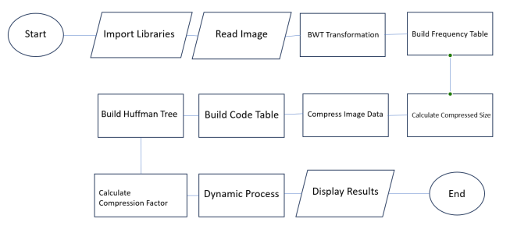
Steps to merge Huffman and BWT Algorithms
Setup: Import required libraries for image handling and data manipulation.
BWT Transformation: Apply Burrows-Wheeler Transform (BWT) to reorder image data.
Huffman Coding: Create a Huffman tree based on symbol frequencies for efficient encoding.
Code Mapping: Generate a mapping of symbols to their Huffman codes.
Compression: Replace image symbols with Huffman codes to compress data.
Size Analysis: Measure compressed data size and calculate compression factor.
Dynamic Process: Read image data in chunks, apply BWT, build Huffman tree, and compress.
Main Execution: Run the process, calculate sizes, and display compression outcomes.

Slide 14
Merged Algorithm Pseudocode
Start image compression and import required libraries for image handling and data manipulation.
Read Image
Apply BWT
Build frequency table
Build Huffman tree
Build code table
Compress image data: replace symbols in BWT with their Huffman codes.
Calculate compressed size
Calculate compression factor
Dynamic process: - Read image data in chunks, apply BWT, build Huffman tree, and compress iteratively.
Display results

Slide 15


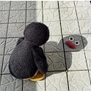
Comparing the compressed images
Huffman Compression:
BWT Compression:
Huffman + BWT Compression:

Slide 16
Quality Assessment
Huffman:
Compression Size: 834899 bits
Compression factor: 1.0044903635050466
BWT:
Compression Size: 838648 bits
Compression factor: 1.0
Huffman + BWT:
Compression Size: 37812 bits
Compression factor: 22.179413942663704

Slide 17
Conculsion
Image Compression Significance: Crucial for reducing image size while preserving vital details.
Study Focus: Explores techniques for effective image size reduction and analyzes methods for their effectiveness and error susceptibility.
Algorithm Efficiency and Error Rates Consistency: While compression levels vary depending on the image, the efficiency of algorithms like Huffman coding and Burrows-Wheeler Transform (BWT) in achieving high compression without loss remains consistent across different image types.
Dynamic Programming Contribution: Further enhances data compression, contributing to overall effectiveness.
Future Outlook: With increasing data creation and transmission needs, advanced algorithms, like those explored, will play a vital role in meeting these demands.

